Slide 1
Lecture 2: Visual processing and more advanced plots
Trevor A. Branch
FISH507H Winter 2011
Beautiful graphics in R

Slide 2
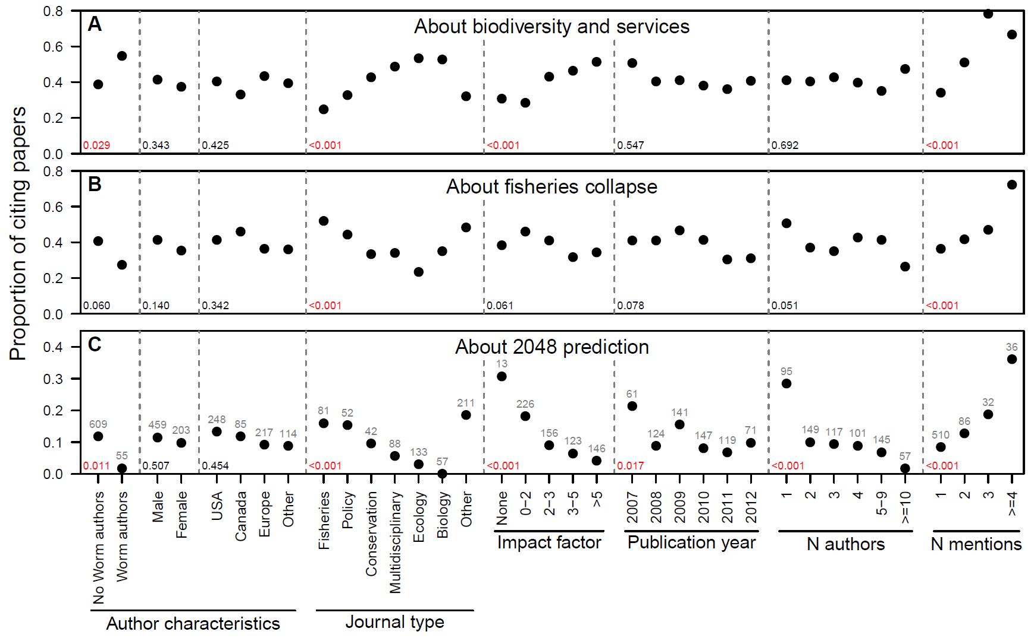

Slide 3
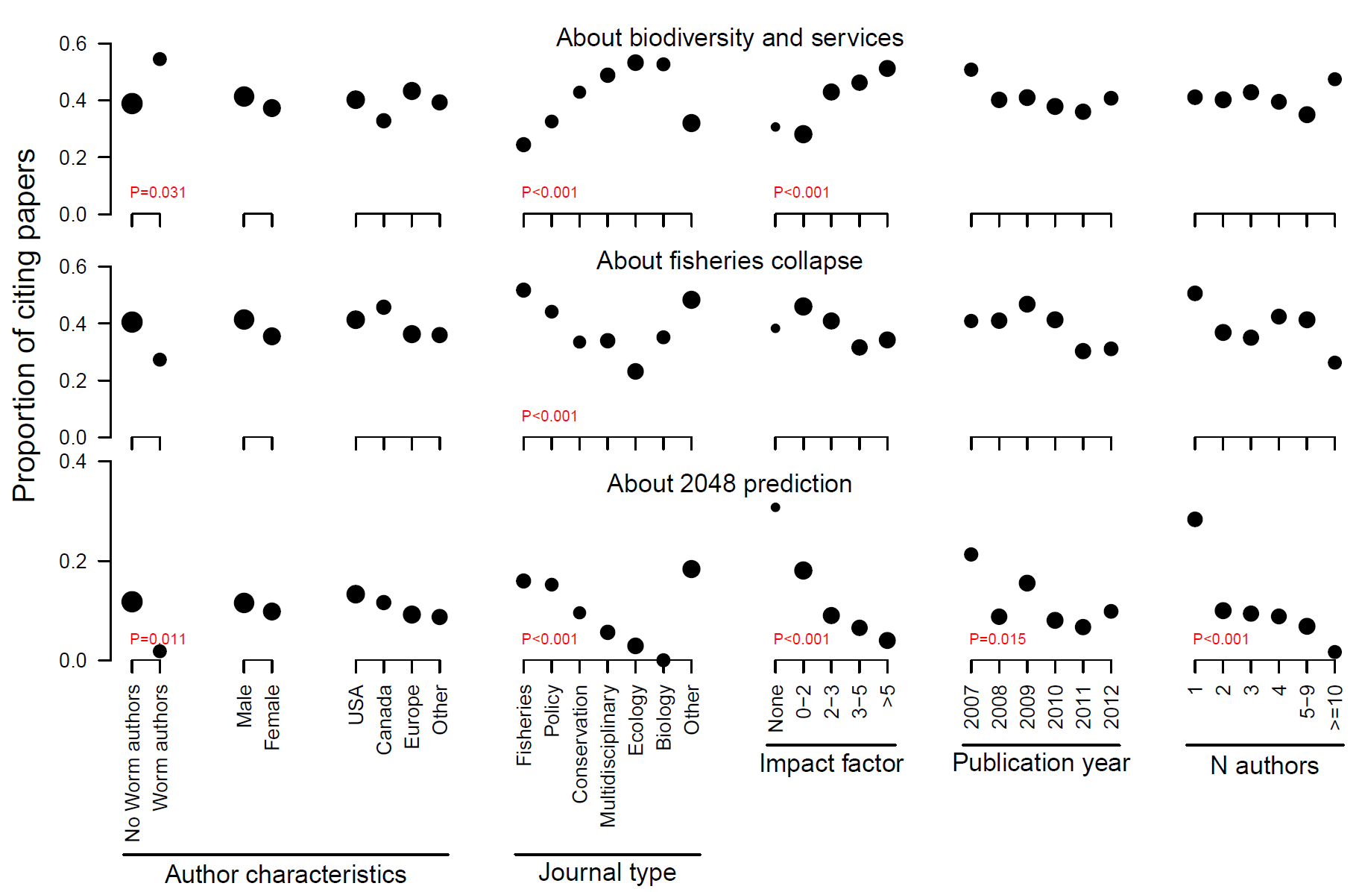
Remove outlines, dashed lines, make circles different sizes for samples sizes, omit non-significant P-values, omit A, B, C labels, more space between groups of points; deleting final group of points; changing y-axis, smaller text for the three rows.

Slide 4
Outline
Visual processing
Horizontal barplots
Using “par”
Symbol, lines, abline
Sparklines
Areaplots and polygon
Solving overplotting using hexbin

Slide 5
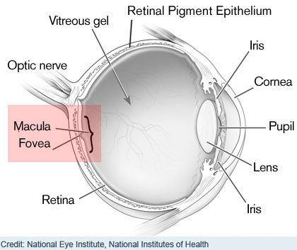
Image: National Eye Institute, National Institutes of Health

Slide 6
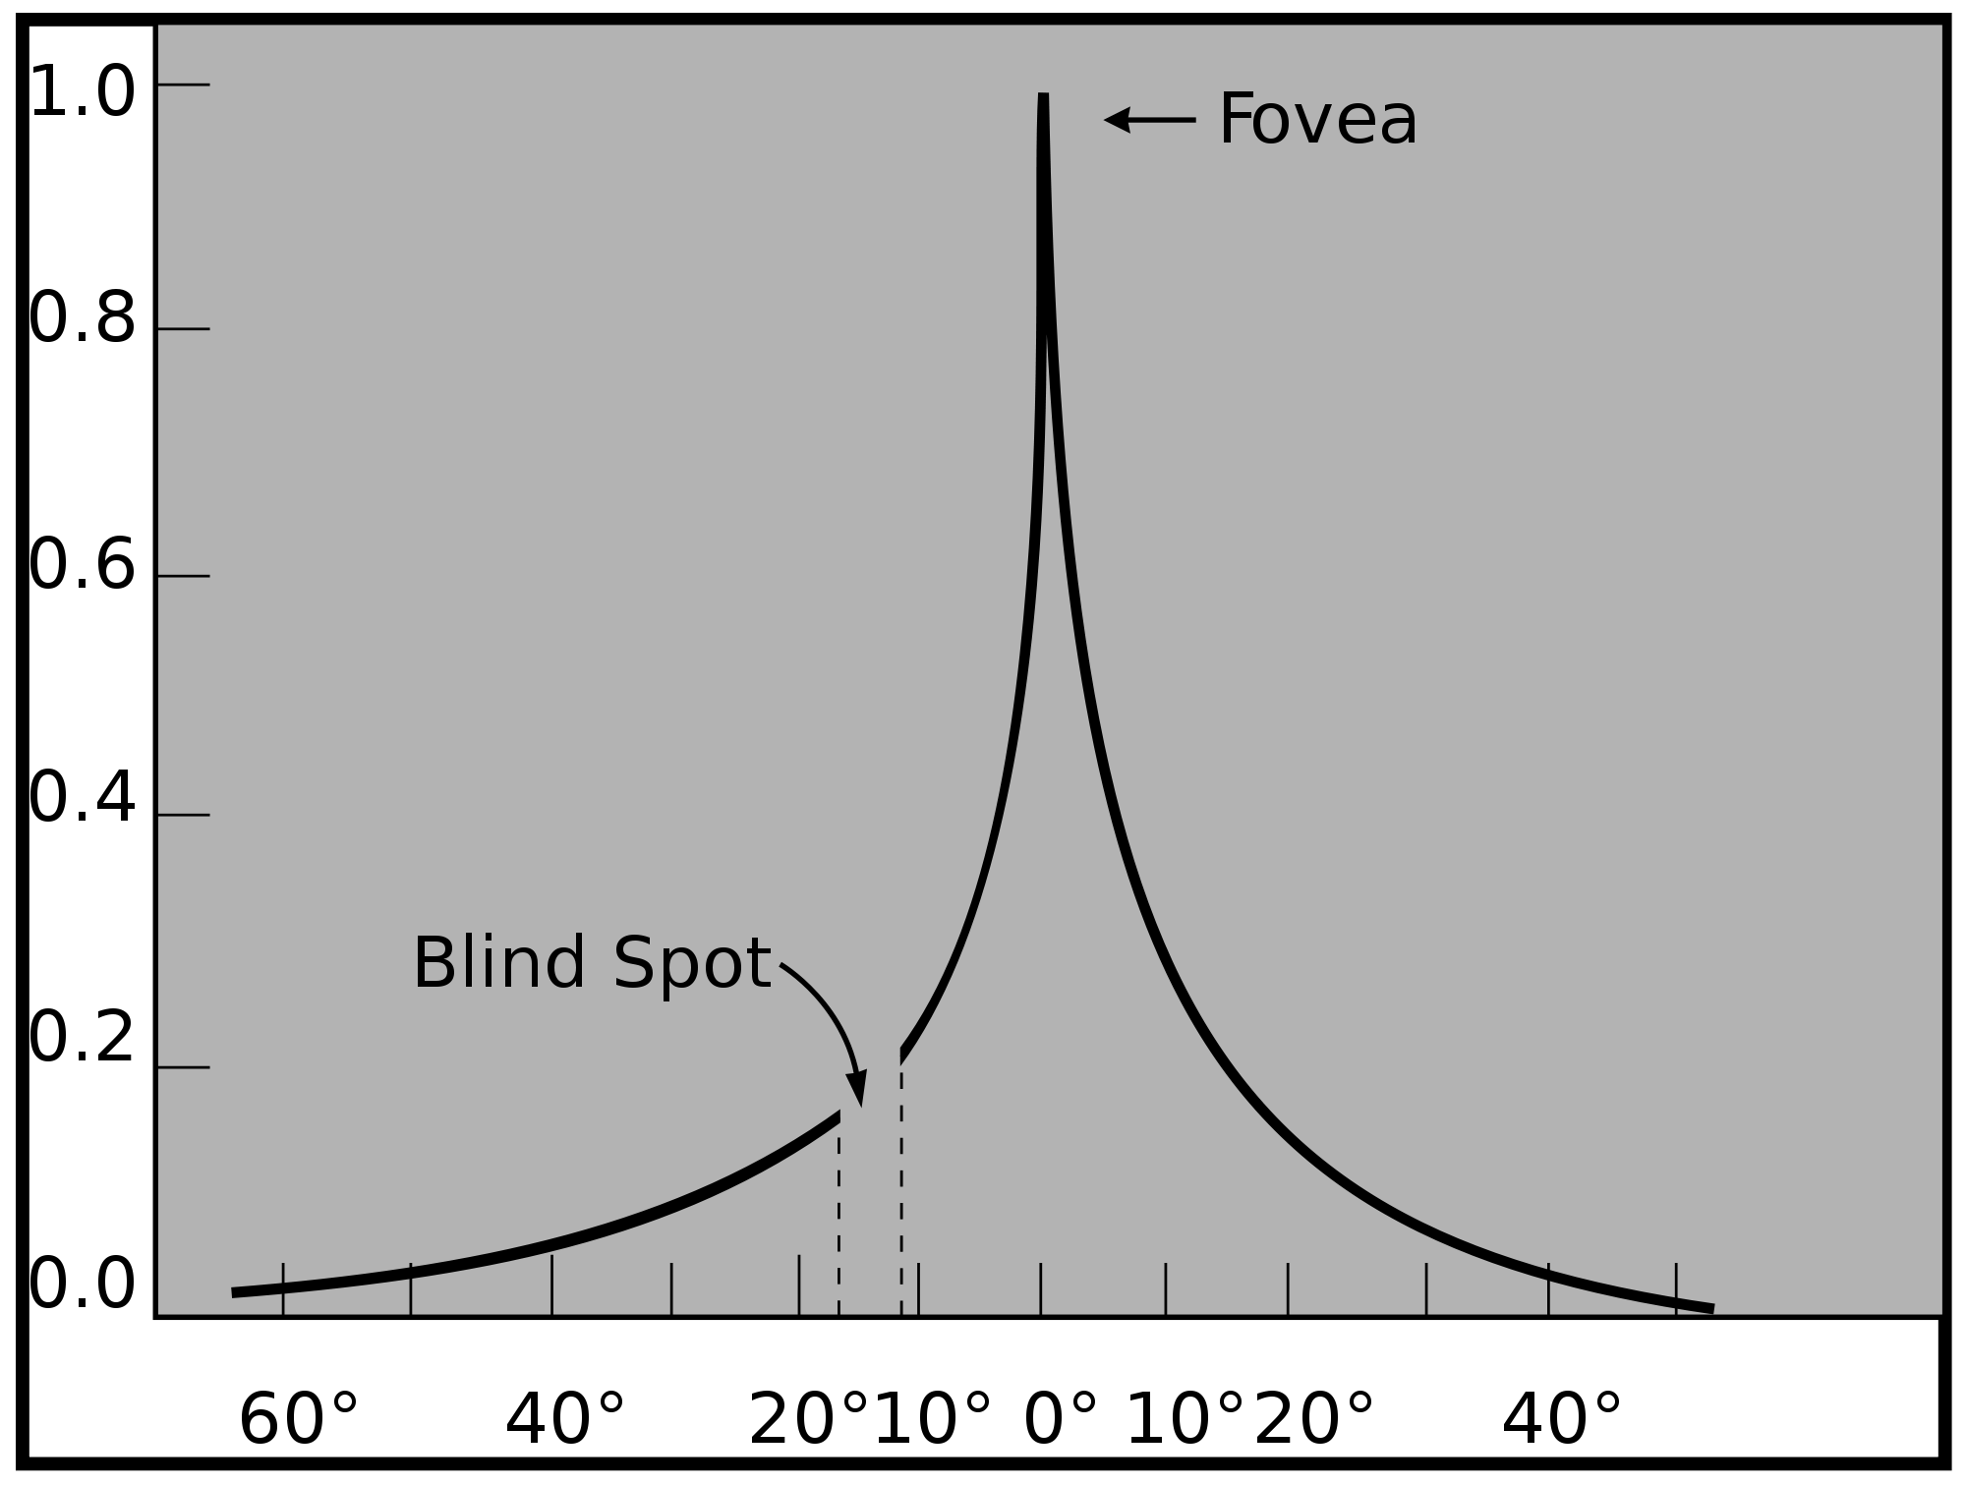
Fovea and blind spot
Relative acuity of left eye
Degrees from fovea
Source: Wikimedia Commons

Slide 7
Blind spot experiment

Slide 8
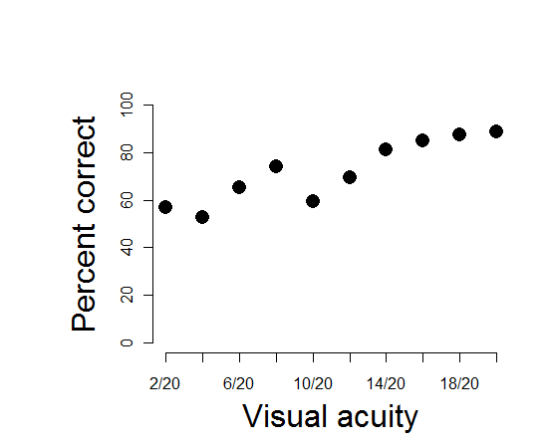
Fovea and concentration
Visual acuity and the concentration of cones (photoreceptors) in the fovea are related to performance in counting tasks
Few (2009) Chapter 3

Slide 9
Video

Slide 10
Handout: explanation of par

Slide 11
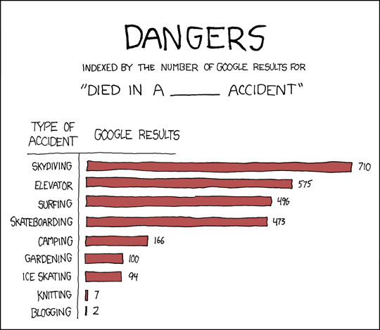
Source: http://xkcd.com/369/

Slide 12
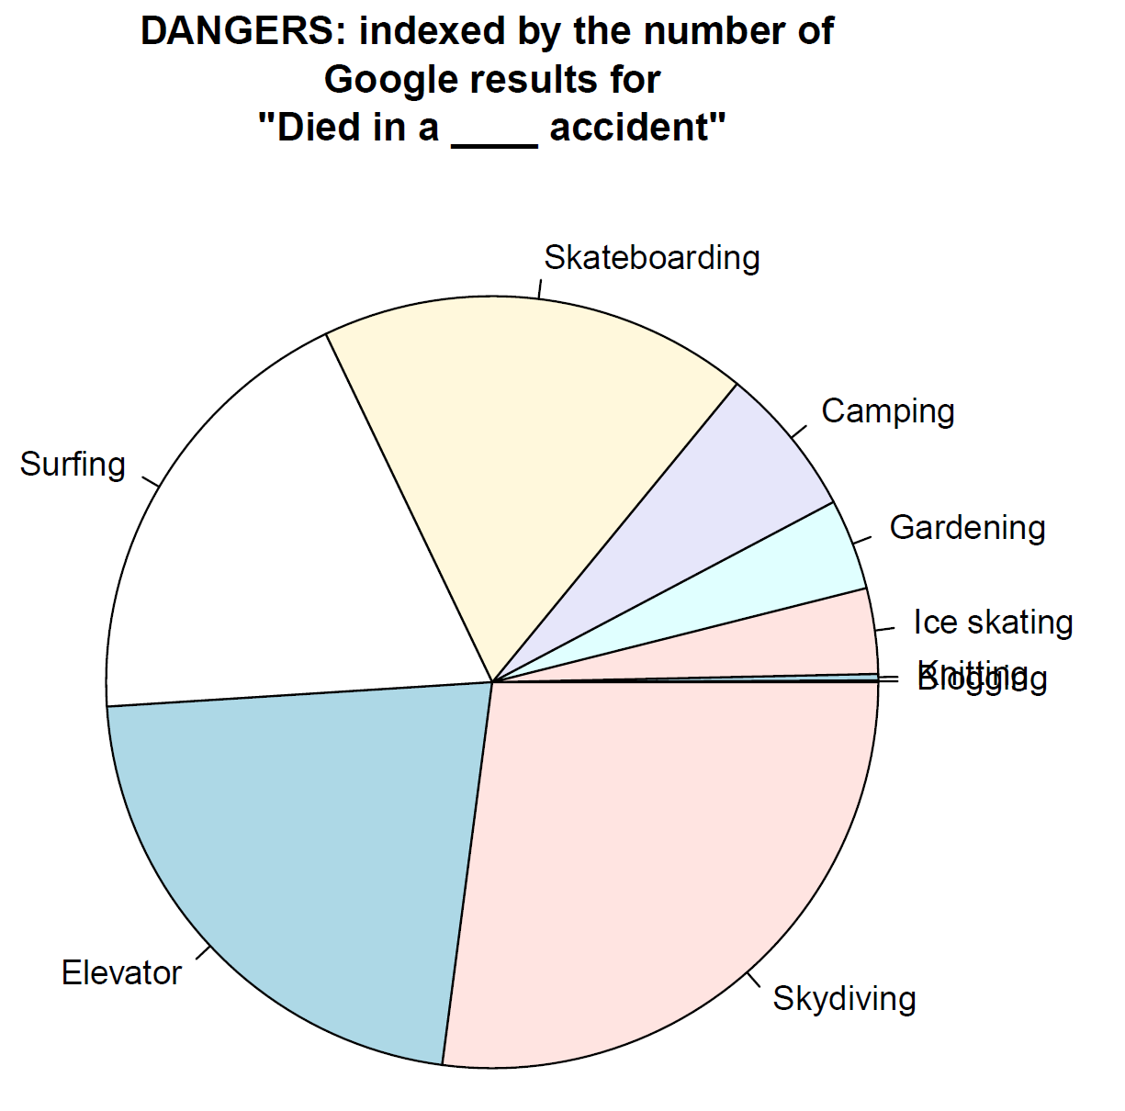
Notes:
###piecharts vs. horizontal barplots
acc <- read.csv("Accidents.csv") #read in data
pie(x=acc$Number, labels=acc$Type) #default unordered piechart
temp <- order(acc$Number) #get sort order from largest to smallest
acc.sort <- acc[temp,] #sort the data and store in a new variable
pdf("Background\\piedied.pdf",width=7,height=7)
pie(x=acc.sort$Number, labels=acc.sort$Type, main="DANGERS: indexed by the number of \nGoogle results for\n\"Died in a ____ accident\"")
dev.off()

Slide 13
Do exercises 1 and 2: xkcd

Slide 14
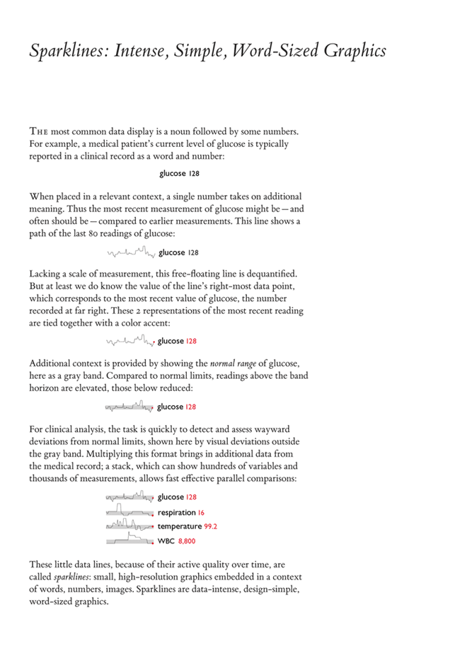

Slide 15
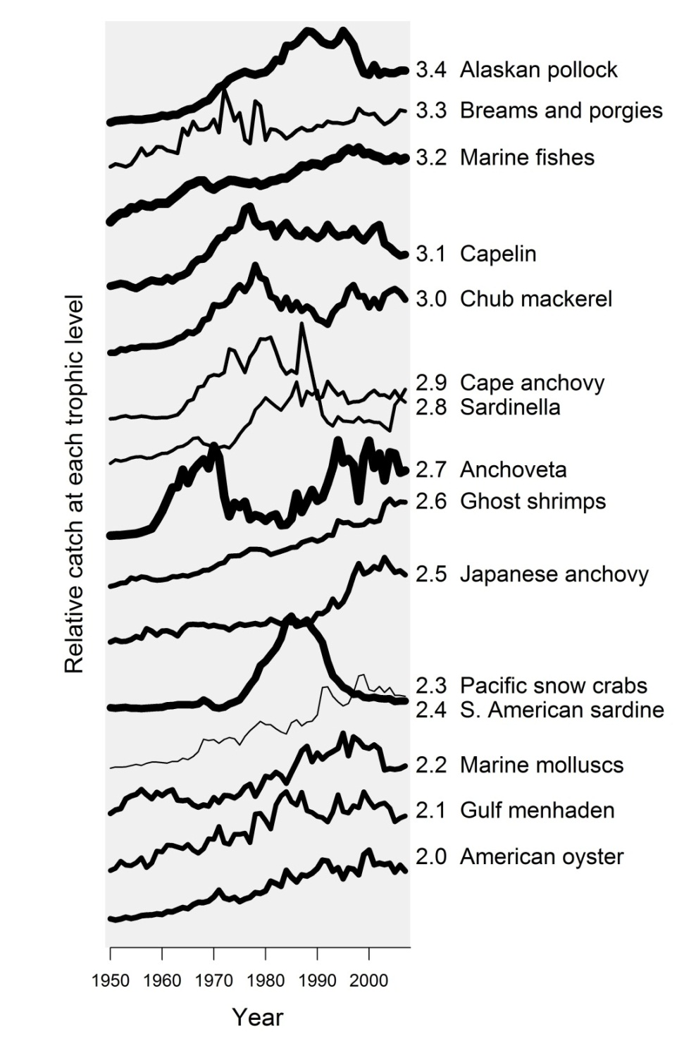
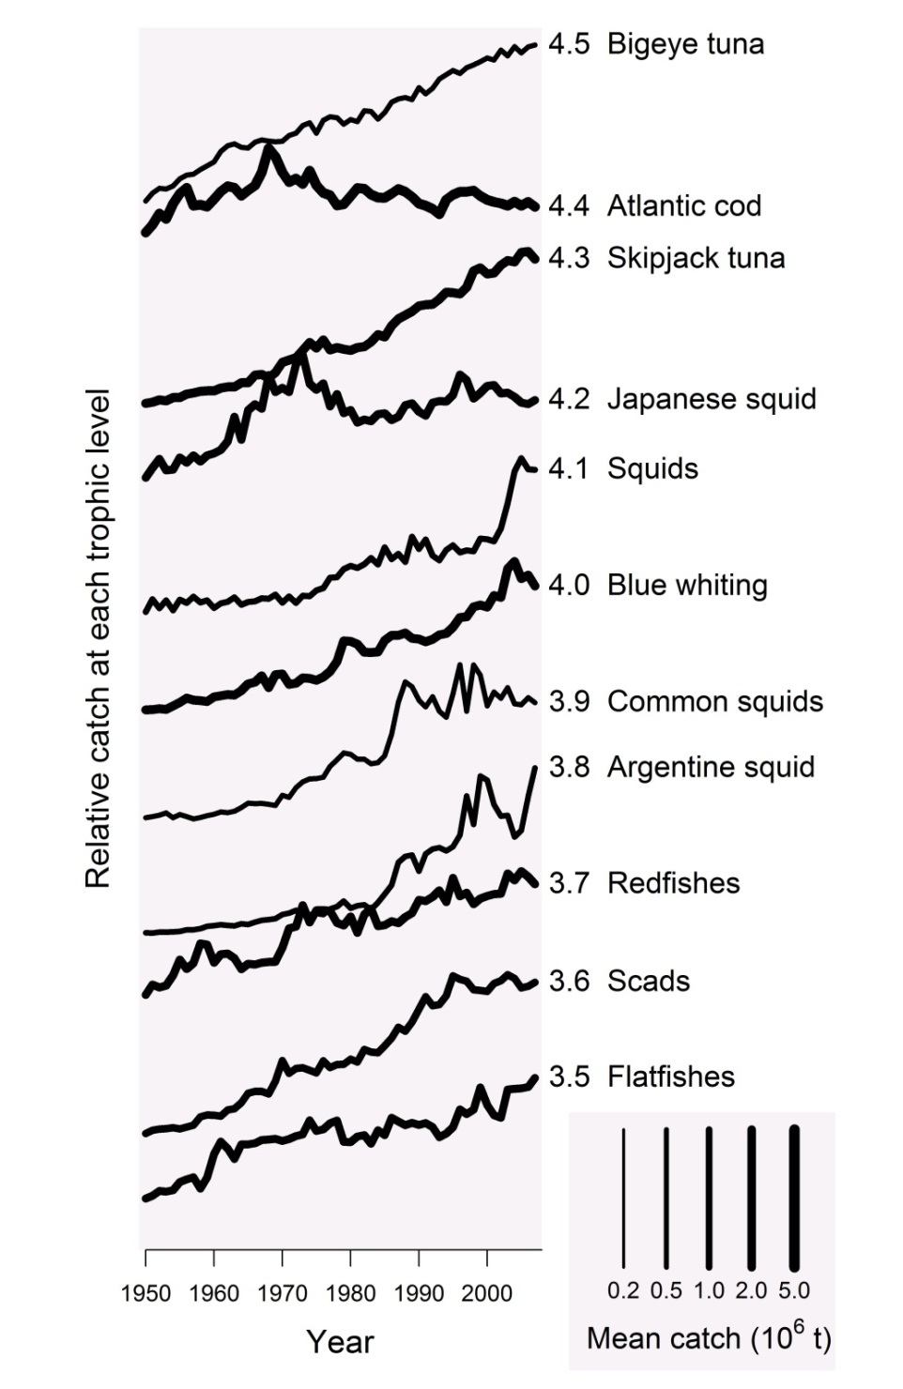
Catch at each trophic level
Year
Year
Branch et al. (2010) Nature 468:431-435

Slide 16
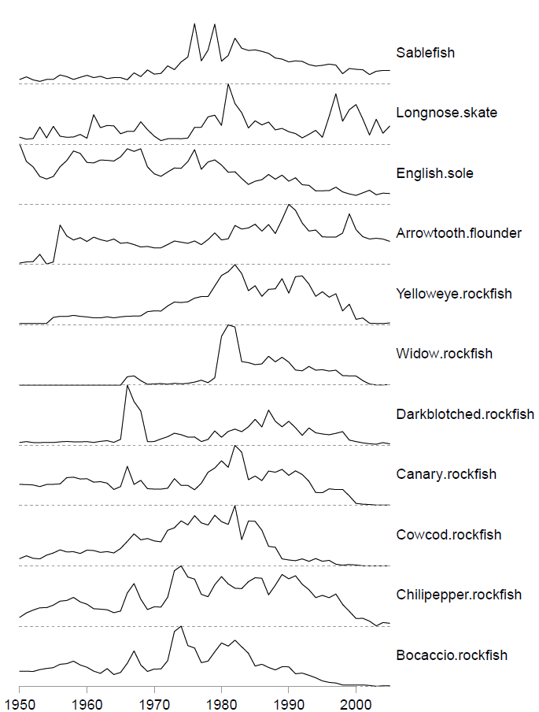
Do exercise 3: West Coast catches using sparklines

Slide 17
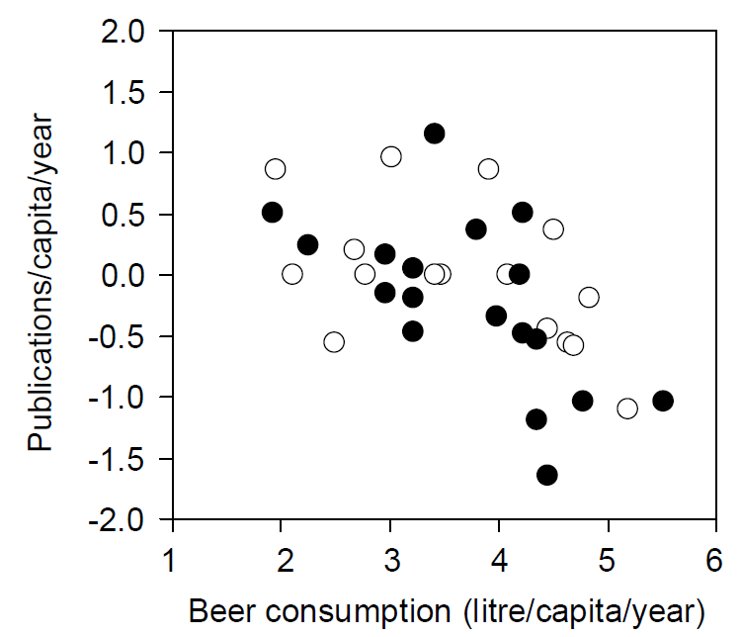
The overplotting problem
Grim T (2008) A possible role of social activity to explain differences in publication output among ecologists. Oikos 117:484-487.
Notes:
Fig. 1. Number of publications per capita per year published by Czech avian ecologists up to 2006 plotted against their beer consumption per capita per year in litres. Both data sets shown are Box-Cox transformed (thus neither the output score nor the consumption score values enable the identification of particular persons included in this research). The negative relationship between beer consumption and publication success is significant not only for the whole data set (rs0.55, n34, p0.0008) but also for ‘‘past’’ (included in the first survey in 2002; m) and ‘‘present’’ researchers (included in 2006; k) analyzed separately (‘‘past’’: rs0.68, n18, p0.002; ‘‘present’’: rs0.52, n16, p0.04).

Slide 18
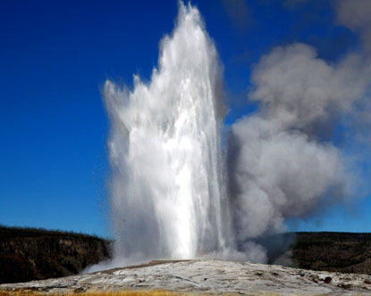
Source: http://www.destination360.com/north-america/us/wyoming/yellowstone-national-park/old-faithful

Slide 19
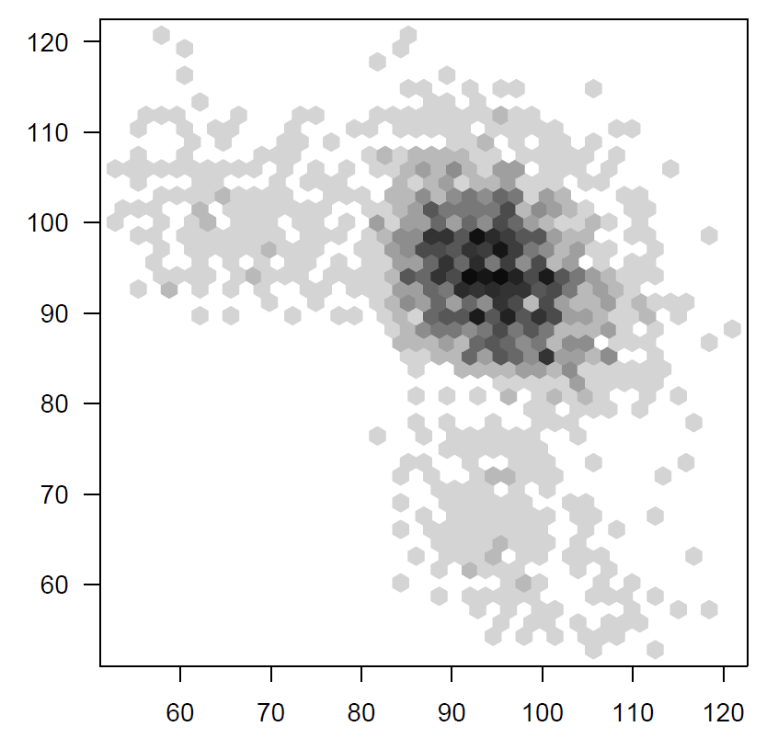
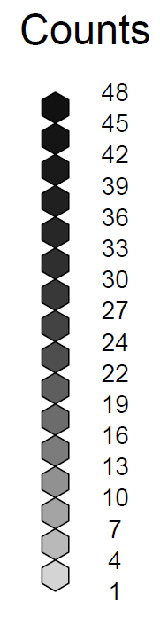
Old Faithful predictions: hexbin
Next interval (min)
This interval (min)

Slide 20
Do exercise 4: overplotting

Slide 21
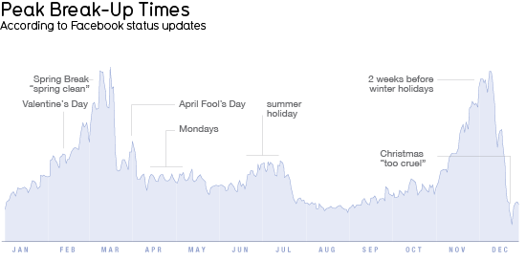
Source: http://www.informationisbeautiful.net/2010/peak-break-up-times-on-facebook/

Slide 22
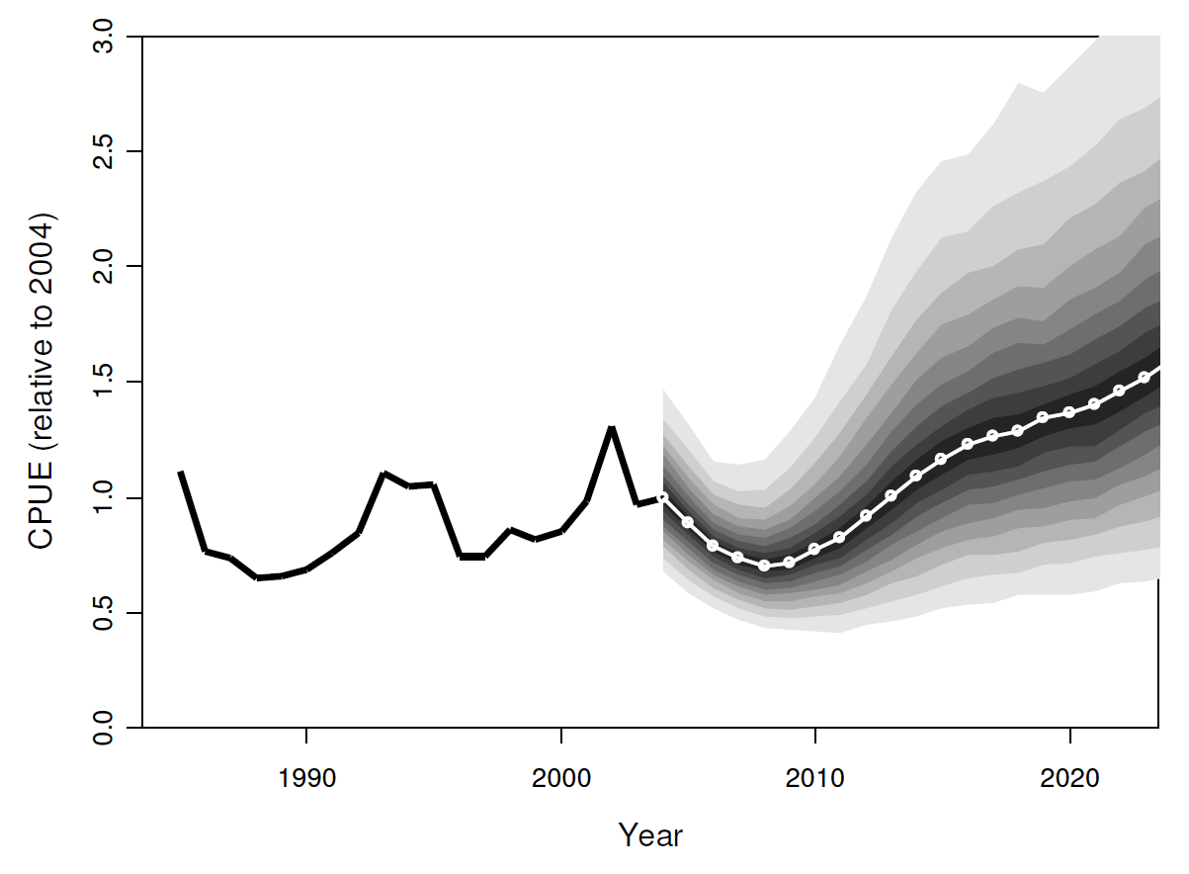
Further uses of polygon()

Slide 23
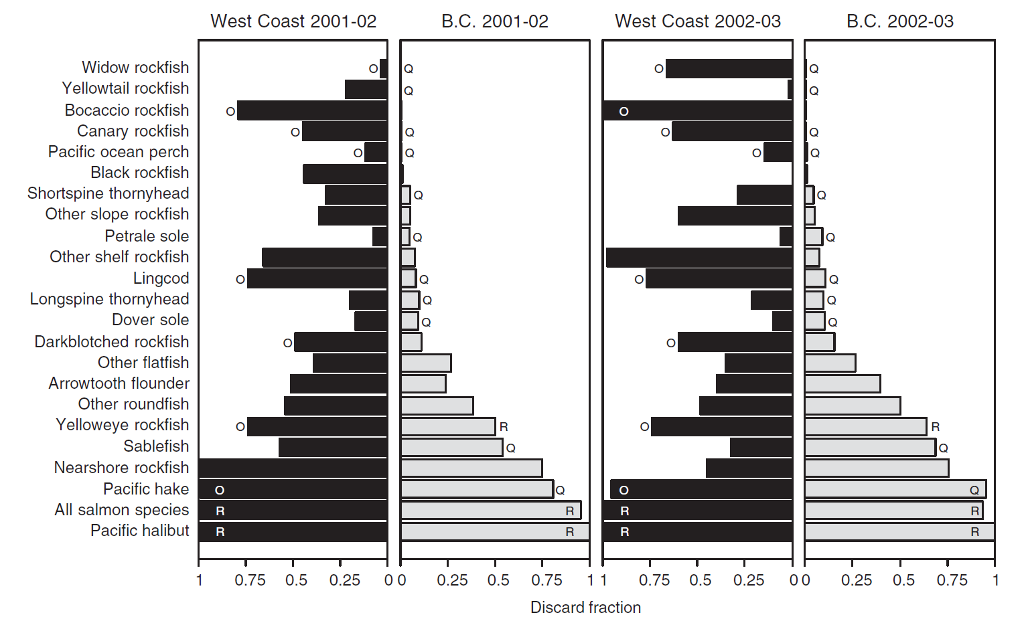
Line shading using col="black" and col="gray50"
Branch et al. (2006) Marine Policy 30:281-296

Slide 24
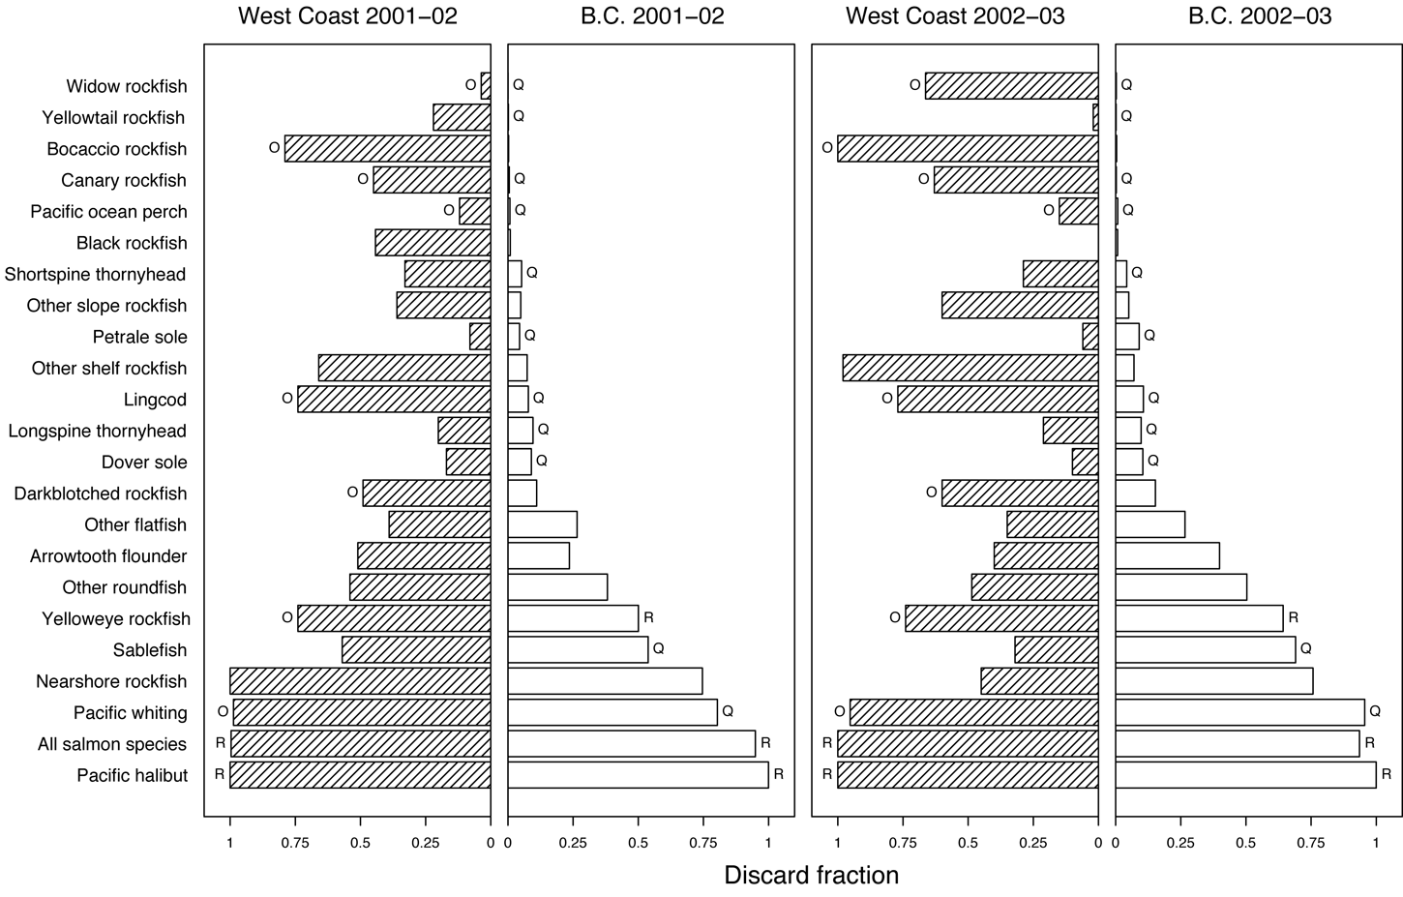
Line shading using angle=45 and number=20
Branch (2006) Bulletin of Marine Science 78:669-690

Slide 25
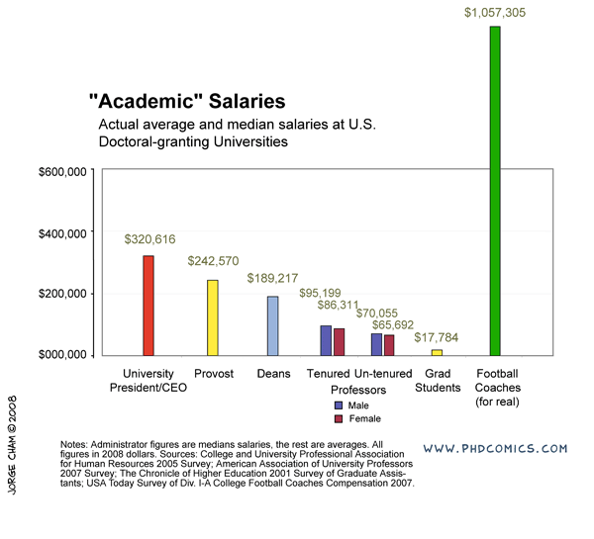
Challenge exercise: Academic salaries
Source: http://www.phdcomics.com/comics/archive.php?comicid=1086

Slide 26
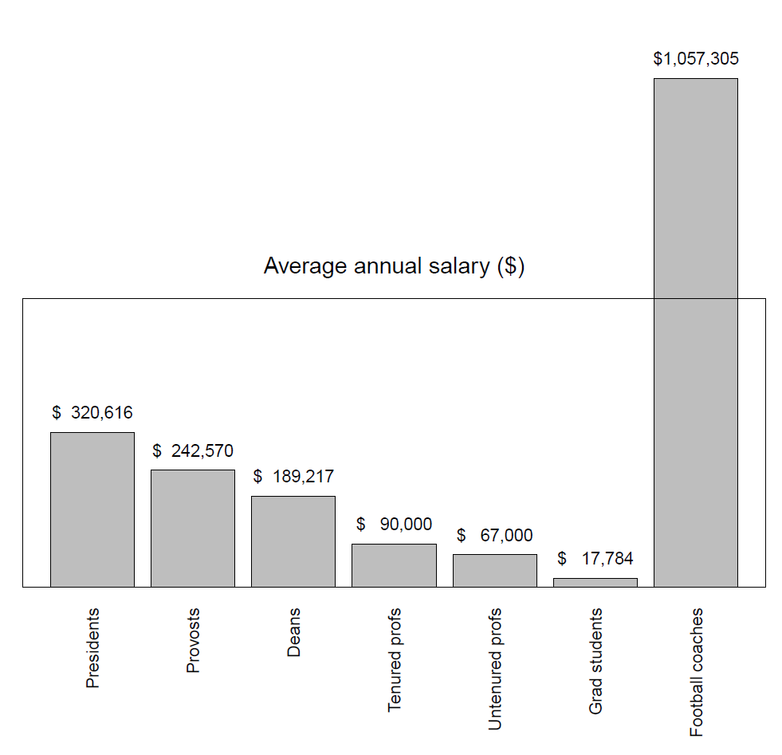
Challenge exercise: Academic salaries

Slide 27
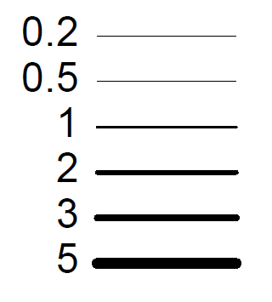
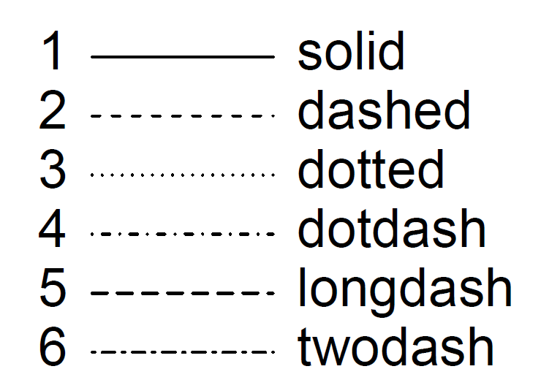
Challenge exercise: Line widths and types
Line width (lwd)
Line type (lty)

